Slide 1



Phases of Natural Language Processing Lecture No.: 3 Course Name: Natural Language Processing Course Code: R1UC616C Instructor Name: Mr. Amit Yadav

Slide 2
Session outline
LEARNING OUTCOMES
ACTIVITY 1
INTRODUCTION TO PHASES OF NLP
FUNCTIONS OF VARIOUS PHASES OF NLP
EXAMPLES
REFLECTION
CONCLUSION

Slide 3

LEARNING OUTCOMES
At the end of this session students will be able to
Analysis varoius phases and concepts of Natural Language Processing (NLP) and its relationship between one phases to another phases.
Identifies word structures like parsing, semantic analysis, sentences and paragraphs

Slide 4

ACTIVITY 1 ( Think pair & share)

Slide 5
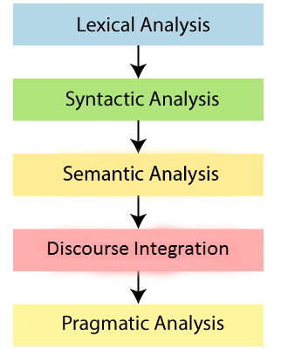
Different Phases of Natural Language Processing

Slide 6
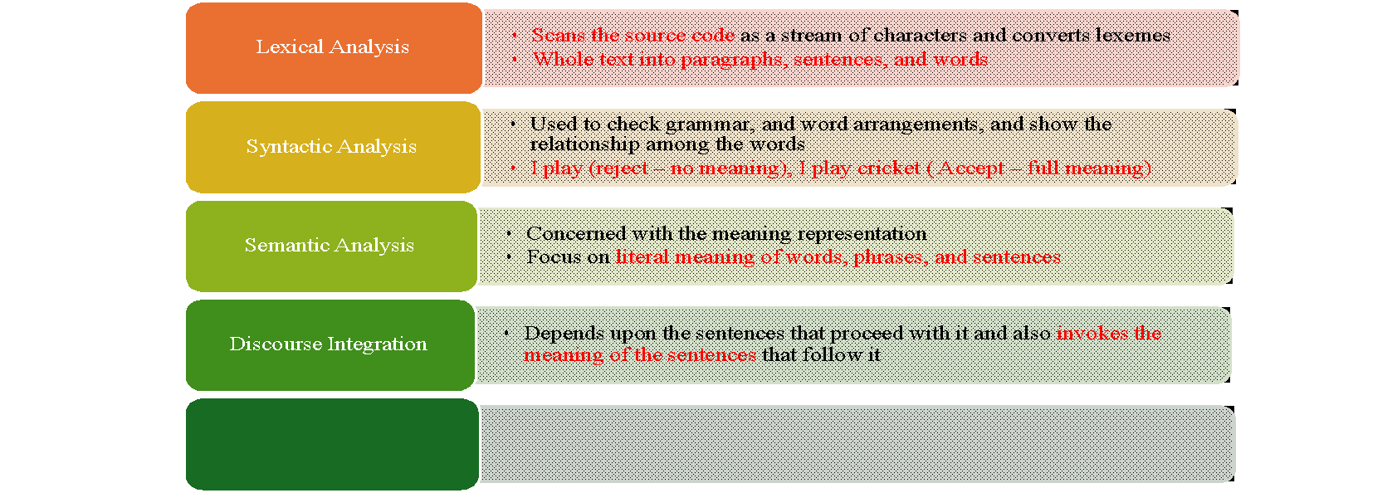
Different Phases of Natural Language Processing

Slide 7
Lexical Analysis:-
The first phase of NLP is the Lexical Analysis.
This phase scans the source code as a stream of characters and converts it into meaningful lexemes.
It divides the whole text into paragraphs, sentences, and words.
Example:-
Input: “I am a super Man!" Output: “I", “am", “a ", “super” “Man!"]

Slide 8
Syntactic Analysis (Parsing) :-
S
Syntactic Analysis is used to check grammar, word arrangements, and shows the relationship among the words.
The sentence such as “The school goes to boy” is rejected by English syntactic analyzer.
Example:-
Incorrect: "He go to school." (Detected as incorrect)
Correct: "He goes to school." (Verified as correct)

Slide 9
Semantic Analysis:-
In this phase, the sentence is checked for the literal meaning of each word and their arrangement together.
It mainly focuses on the literal meaning of words, phrases, and sentences.
The semantic analyzer disregards sentence such as “hot ice-cream”.
Example:-
The sentence “I ate hot ice cream” will get rejected by the semantic analyzer because it doesn’t make sense.

Slide 10
Types of Literals
Literals are fixed values that are directly written into the code. They represent constant values and do not require computation to be assigned.
1. Numeric Literals - Represent numbers.
(i). Integer (e.g., 10, -5) (ii). Floating-point (e.g., 3.14, -0.001) (iii). Complex (e.g., 3 + 4j in Python)
2. String Literals - Represent text enclosed in quotes.
Single-quoted ('Hello')
Double-quoted ("World")
Multi-line (e.g., '''This is a multi-line string''')
3. Boolean Literals - Represent truth values. (ex: TRUE and FALSE)
4. Character Literals - Represent a single character. (EX: “A” “B”)
5. Null Literal - Represents "no value" or "nothing.“ (Ex: “Null” “ None”)
6. Collection Literals - Represent data structures.
List [1, 2, 3] (Python)
Dictionary {"key": "value"} (Python)
Array {1, 2, 3} (JavaScript)

Slide 11
Discourse Integration:-
The fourth phase is discourse integration. In this phase, the impact of the sentences before a particular sentence and the effect of the current sentence on the upcoming sentences is determined.
Pronoun Resolution – Identifying what pronouns (e.g., he, she, it) refer to in a conversation.
Example:
John went to the store. He bought some milk.
Here, "He" refers to "John."
Example:-
The word “that” in the sentence “He wanted that” depends upon the prior discourse context.

Slide 12
Pragmatic Analysis:-
Understanding the context of the sentence
Interpreting implied meanings.
Example: "Can you open the door?" → It’s a request, not just a question.
Example:
"Open the door" is interpreted as a request instead of an order.
Sentence: "Can you open the window?" Outcome: Interpreted as a request, not just a question.

Slide 13
Speech Recognition & Synthesis in NLP
Speech Recognition and Speech Synthesis are essential components of Natural Language Processing (NLP) that enable machines to convert speech to text and text to speech, respectively.
Speech Recognition converts spoken language into written text. It involves analyzing audio signals, identifying words, and transcribing them accurately.
These technologies are widely used in voice assistants, transcription services, and accessibility tools.

Slide 14

REFLECTION (MCQ)
https://app.wooflash.com/moodle/I0QEUZDD
I0QEUZDD
https:// www.youtube.com/watch?v=807Blw7ca48

Slide 15
Conclusion
Natural Language Processing (NLP) is a multi-step process that enables machines to understand, process, and generate human language effectively. Each phase plays a crucial role in transforming raw text into meaningful insights:
Lexical Analysis breaks text into tokens for further processing.
Syntactic Analysis ensures proper grammatical structure.
Semantic Analysis extracts meaning and resolves word ambiguities.
Pragmatic Analysis interprets real-world context and user intent.
Discourse Analysis helps maintain coherence across sentences and conversations.
Speech Recognition & Synthesis enable interaction through voice-based input and output.

Slide 16
Information to next topic of the course
Next Lecture: Language Modeling - Basics of N-Gram Models
Go through the lecture
https://www.youtube.com/watch?v=MM48kc5Zq8A

Slide 17



Review and Reflection from students

